Slide 1
Fast food wait-times
Drew gravitt

Slide 2
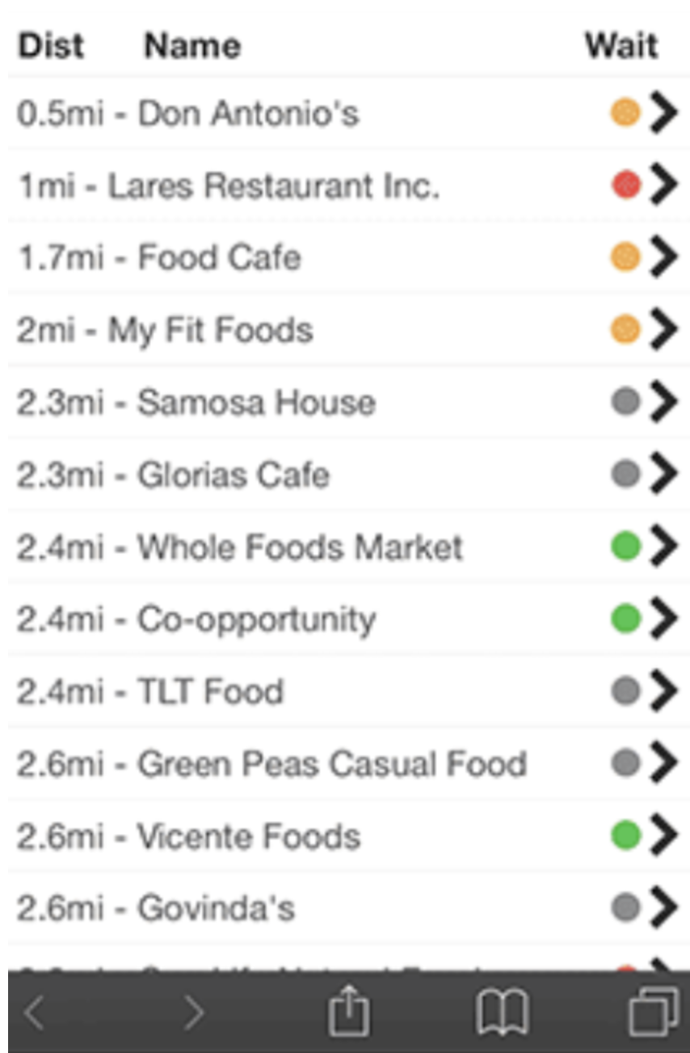
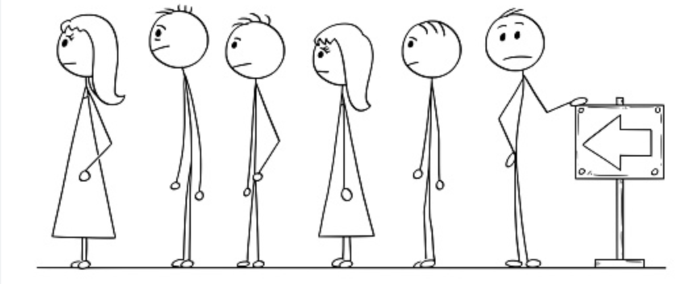
The wait is over!
This app will show each user the current wait-times for drive-through lines, given permission is granted for the app to use the user’s “current location”.
https://github.com/ksu-is/FastFoodWaitTime
Above is what the app would similarly look like

